Slide 1
Hydrogenation of InGaAsN/GaAs QW Samples
Mayank Shekhar Sharma
“La Sapienza” University of Rome

Slide 2
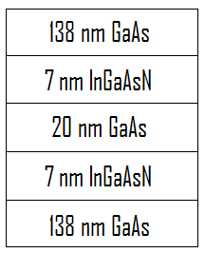
Samples layout and preparation details of Quantum Wells
The samples were obtained using the technique of Metal Organic Vapour Phase Epitaxy (MOVPE) from University of Marburg (UMR).
Four samples were obtained under different conditions:
Sample | Growth rate | Ga precursor
14464 | Slow | TEGa
14465 | Fast | TEGa
14469 | Slow | TMGa
14470 | Fast | TMGa

Slide 3
Raw Samples without Hydrogenation
Photoluminescence (PL) spectra recorded at room temperature on each of the four couples of InGaAsN QWs. Notice the difference in the PL peaks.
Samples were expected to emit at 0.95eV (1.31μm) or lower energy to be used for our purpose. The closest to the ideal here is sample 14470 with high intensity spectra at lower energy.
Figure 1: Photoluminescence (PL) spectra of four couples of InGaAsN QWs.

Slide 4
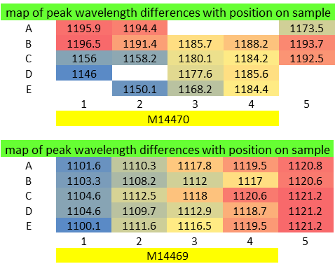
Inhomogeneity in Raw Samples
Samples were found to be inhomogeneous in their emitted wavelength with respect to the position of excitation (Δλ ~ 20-50 nm).
Inhomogeneity is not random, but has a trend which has a minima and maxima in certain parts of the sample.

Slide 5
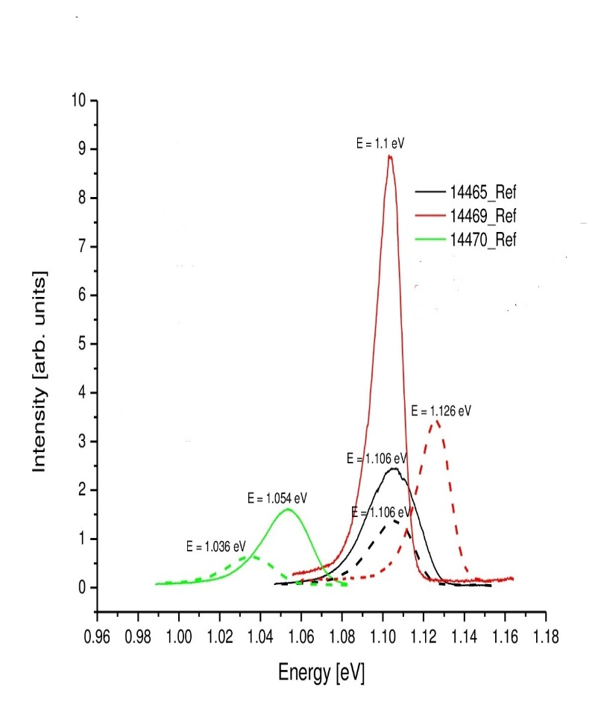
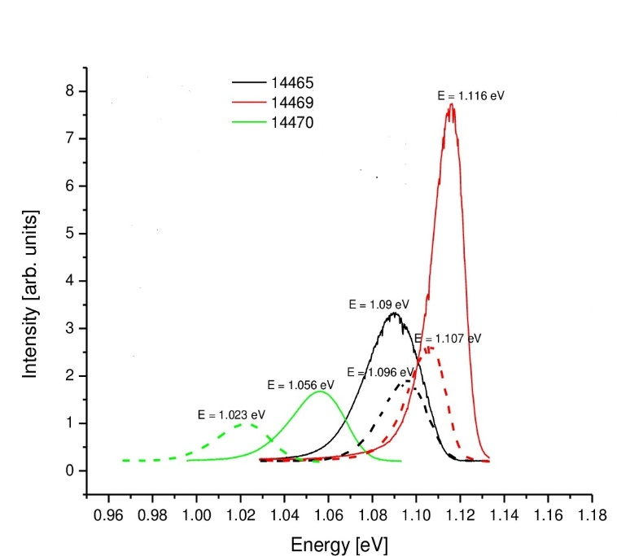
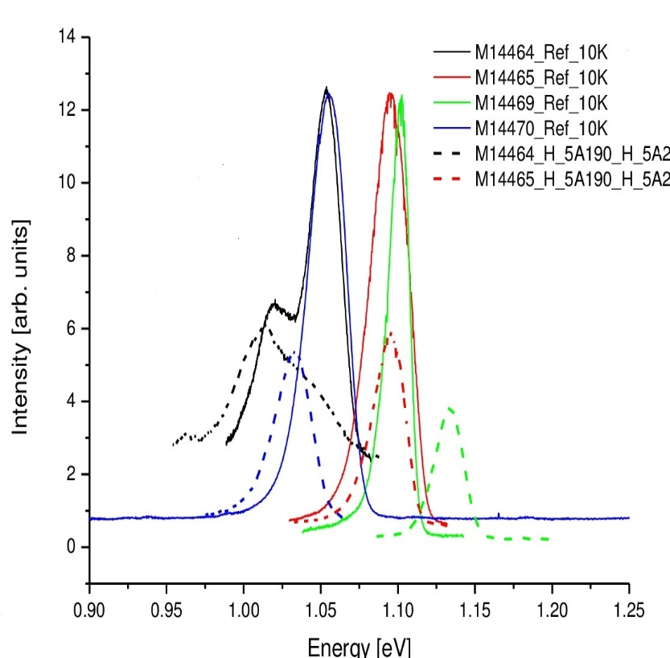
Varying Hydrogenation doses
The samples were cleaned and then given different hydrogen doses at different temperatures.
The hydrogenation at low temperature (10K) has only decreased the intensity, without any shift in the peak position.
No shift in peak position (i.e., no blue-shift in particular) means no pronounced effect on hydrogenation on the samples.
Figure 2: Hydrogenation for a dose 5A (5*10¹⁶ ions/cm²) at 190ºC
Figure 3: Hydrogenation for a dose 2B (2*10¹⁷ ions/cm²) at 190ºC
Figure 4: Hydrogenation for a dose 5A* (5*10¹⁶ ions/cm² twice ) at 190ºC

Slide 6
Was anything wrong with the hydrogenation system?

Slide 7
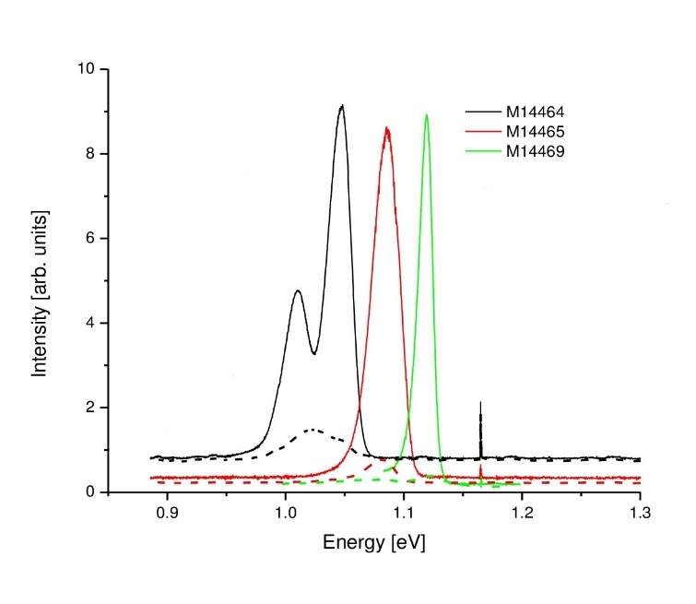
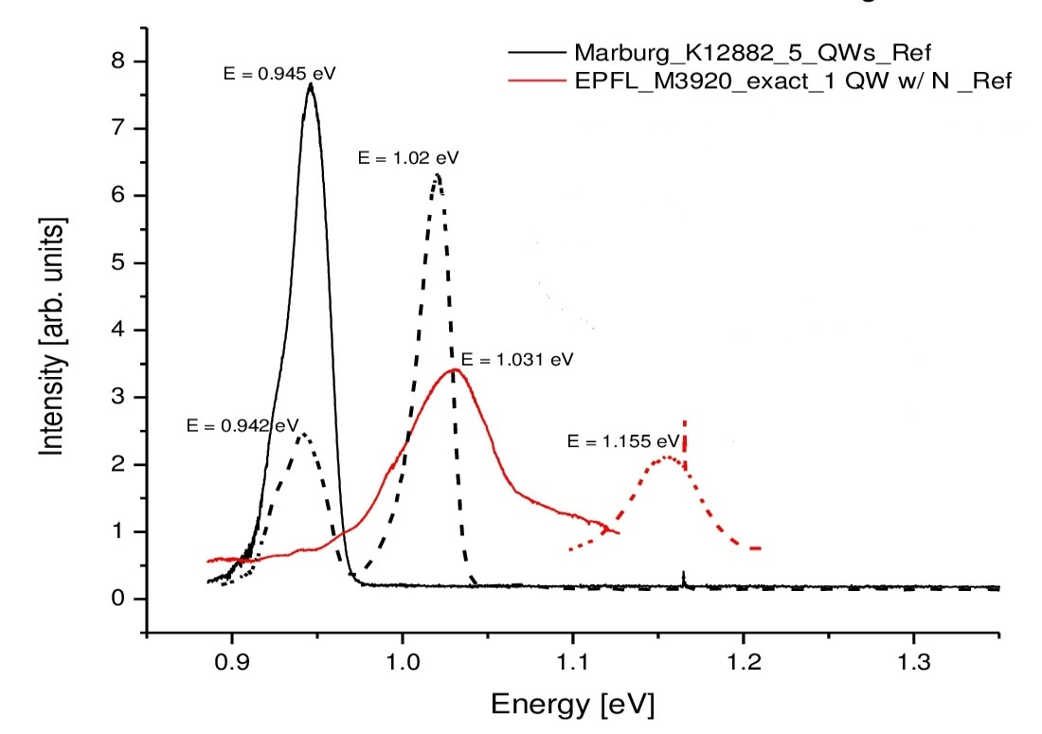
Comparison of our samples with old samples from Marburg & EPFL
To crosscheck whether there is any fault with our hydrogenation apparatus, we placed old samples of InGaAsN from the same group of UMR (K12882) and from EPFL (M3920) along with our samples.
Results were positive in the case of old samples, while negative for ours.
Figure 5: Hydrogenation for a dose 1B (1*10¹⁷ ions/cm²) at 300ºC. Left graph shows data for our new samples while right shows the data for the old samples from UMR and EPFL.

Slide 8
Conclusions
No peak shifting was observed under all the hydrogenation conditions that were tried.
Significant Intensity loss (50-70% loss) was observed in all hydrogenated samples, for all hydrogenations performed at 190* C and 250* C.
Severe intensity loss ( > 95% loss) was observed for samples hydrogenated at 300* C.
K12882 samples, consisting of seemingly similar QWs that were hydrogenated together with our samples, showed peak shifting and intensity relations as expected and similar to old data. This indicates:
K12882 underwent (partial) N-passivation.
No experimental error was made in performing the hydrogenations.
Experimental conditions were suitable for (at least partially) hydrogenating the samples supplied.

Slide 9
THANK YOU…

